Slide 1
Computer Vision Introduction and
Whole-Image Features
CSCI 4150/6050: Computer Vision
Slide Credits: Modified from slides by Kristin Grauman at UT-Austin, Bryan Morse and Ryan Farrell at BYU
Additional slide credits as noted

Slide 2
Graphics, Image Processing, and Vision
Graphics
Scene
Descriptions
Image
Vision
Image Processing
Now we will focus on this one.
Only focused on this part so far.

Slide 3
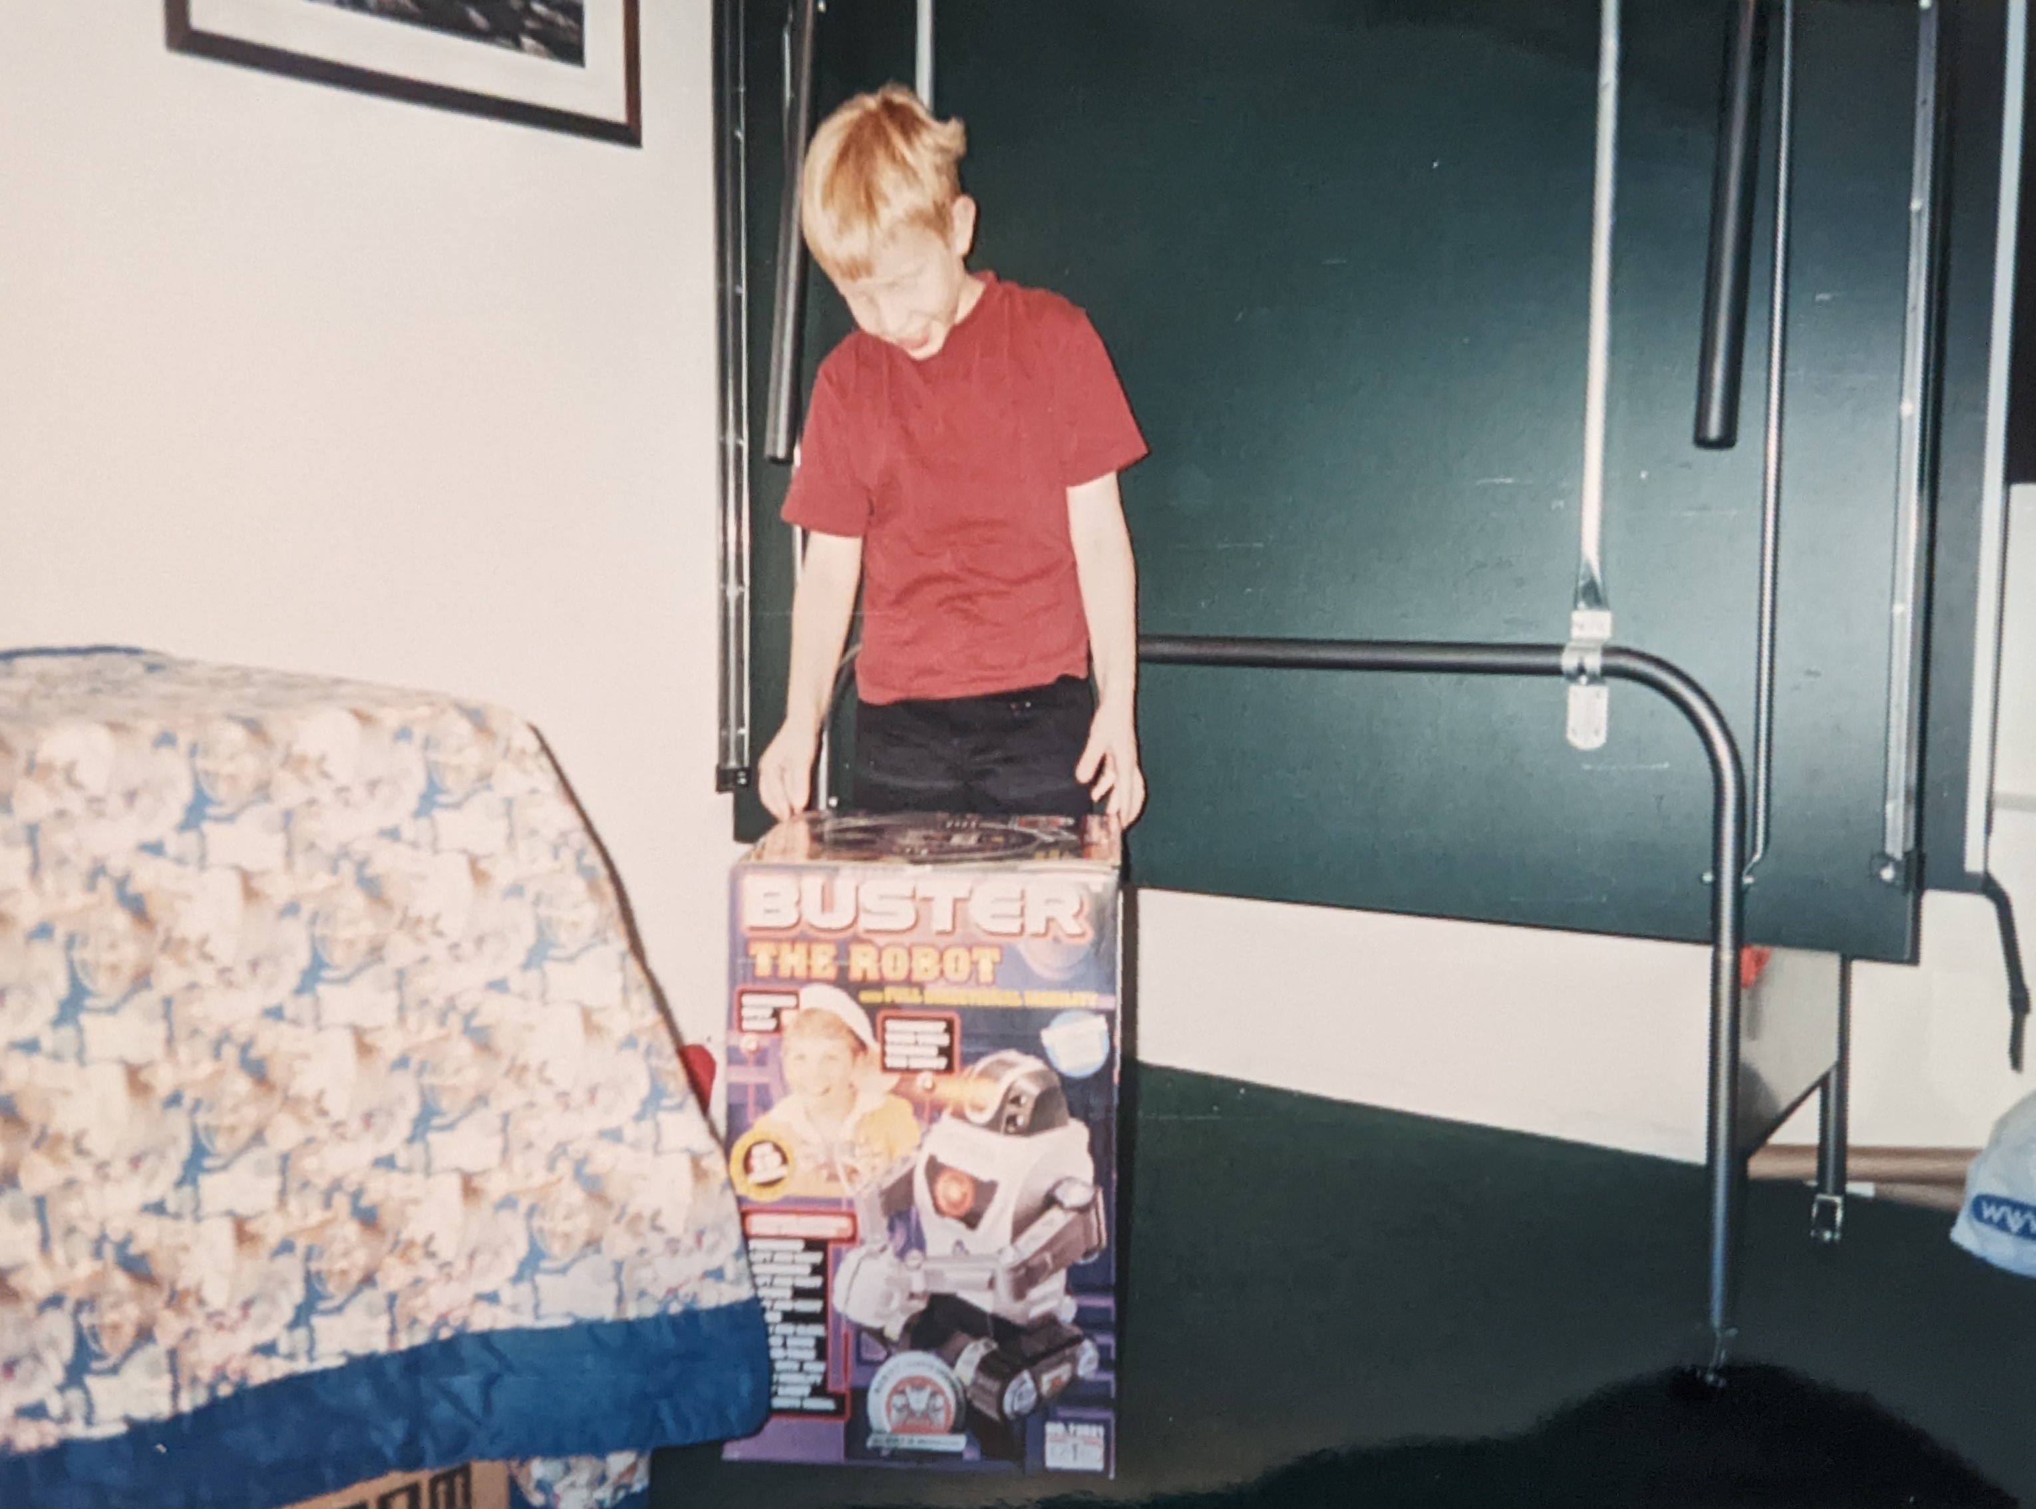
Buster the Robot

Slide 4
Meet Buster
Let’s try and teach Buster to understand images.

Slide 5
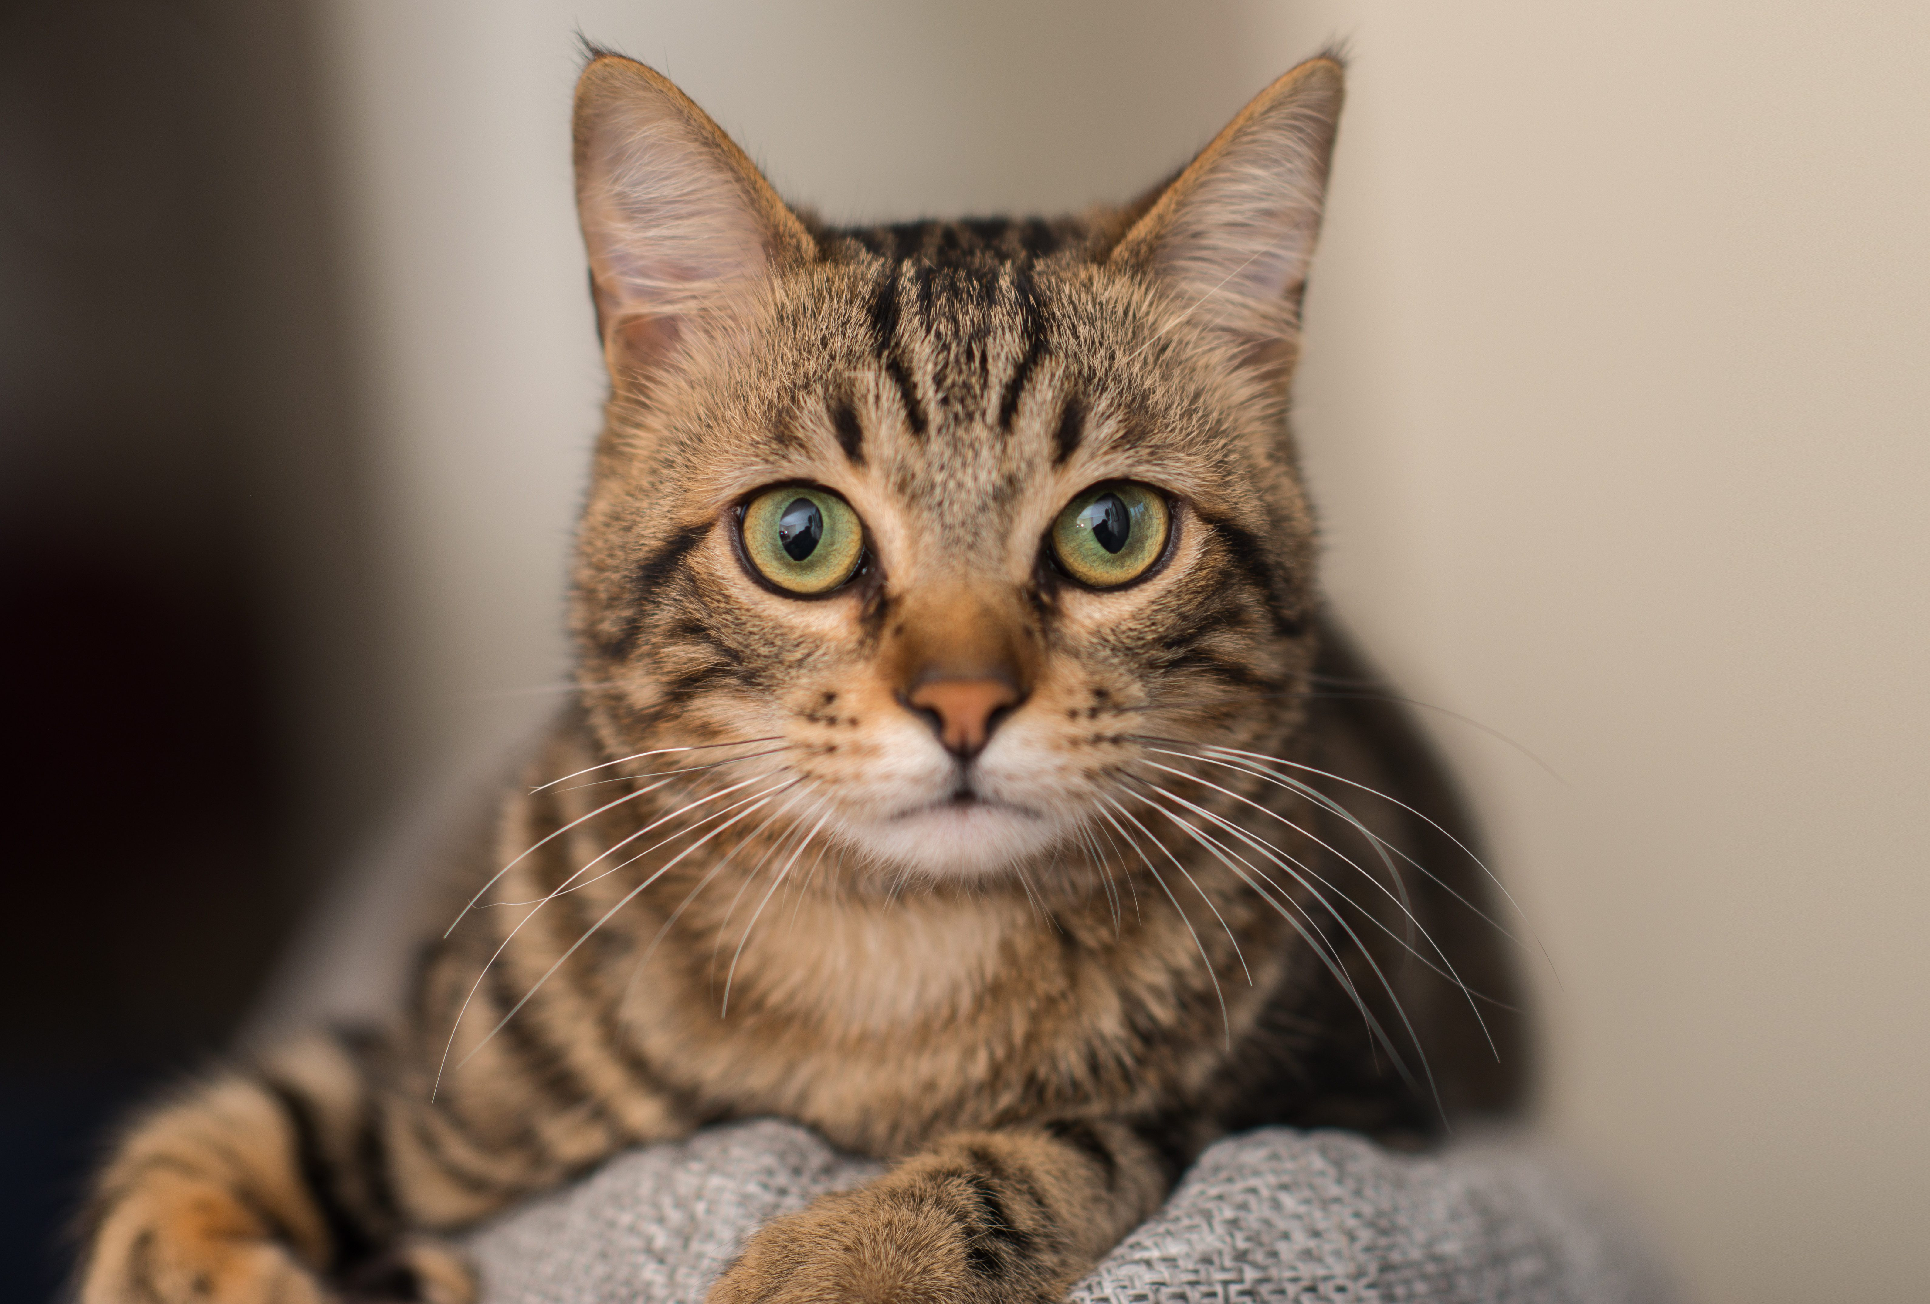

What we see…
This is a cat!
AARON AMAT/SHUTTERSTOCK

Slide 6
What the computer sees…
54 | 70 | 62 | 37 | 56 | 180 | 205 | 198 | 213 | 163 | 207 | 214 | 66 | 237 | 100 | 12 | 247 | 22 | 30 | 67 | 115 | 163 | 37 | 144 | 48 | 47
74 | 168 | 30 | 221 | 219 | 38 | 70 | 172 | 101 | 93 | 159 | 233 | 93 | 69 | 14 | 144 | 125 | 52 | 30 | 136 | 35 | 53 | 117 | 179 | 217 | 133
5 | 22 | 250 | 193 | 178 | 40 | 154 | 7 | 192 | 134 | 182 | 21 | 88 | 57 | 15 | 118 | 152 | 46 | 12 | 212 | 152 | 234 | 192 | 27 | 220 | 33
56 | 189 | 195 | 152 | 35 | 208 | 26 | 56 | 82 | 50 | 131 | 173 | 63 | 84 | 93 | 170 | 49 | 148 | 232 | 20 | 51 | 108 | 3 | 100 | 24 | 8
250 | 252 | 213 | 254 | 171 | 110 | 76 | 144 | 198 | 148 | 3 | 119 | 205 | 139 | 68 | 168 | 13 | 168 | 199 | 236 | 186 | 207 | 150 | 102 | 231 | 146
234 | 119 | 158 | 239 | 61 | 74 | 157 | 135 | 141 | 64 | 209 | 207 | 145 | 216 | 251 | 224 | 177 | 74 | 14 | 79 | 10 | 62 | 135 | 196 | 130 | 228
108 | 197 | 226 | 214 | 10 | 169 | 185 | 130 | 116 | 16 | 226 | 25 | 120 | 181 | 115 | 44 | 112 | 196 | 26 | 130 | 185 | 7 | 189 | 174 | 240 | 56
11 | 181 | 235 | 202 | 129 | 199 | 219 | 10 | 114 | 168 | 202 | 214 | 202 | 99 | 176 | 98 | 1 | 110 | 100 | 32 | 210 | 111 | 35 | 112 | 130 | 25
232 | 204 | 125 | 35 | 55 | 238 | 209 | 9 | 188 | 153 | 86 | 205 | 197 | 20 | 58 | 180 | 162 | 219 | 130 | 148 | 200 | 93 | 250 | 111 | 140 | 136
92 | 201 | 231 | 3 | 229 | 95 | 32 | 203 | 1 | 57 | 28 | 154 | 143 | 147 | 149 | 234 | 49 | 76 | 212 | 82 | 242 | 42 | 124 | 149 | 243 | 248
102 | 239 | 2 | 88 | 64 | 0 | 148 | 40 | 238 | 173 | 195 | 252 | 148 | 232 | 85 | 6 | 213 | 231 | 126 | 33 | 171 | 219 | 189 | 13 | 120 | 145
149 | 149 | 66 | 104 | 13 | 153 | 26 | 144 | 46 | 7 | 101 | 64 | 73 | 121 | 222 | 68 | 220 | 95 | 17 | 40 | 132 | 239 | 187 | 63 | 111 | 0
161 | 129 | 133 | 164 | 2 | 127 | 187 | 231 | 42 | 136 | 66 | 72 | 29 | 175 | 196 | 105 | 187 | 55 | 167 | 130 | 254 | 127 | 236 | 233 | 20 | 155
13 | 7 | 95 | 24 | 78 | 14 | 72 | 22 | 122 | 89 | 151 | 197 | 187 | 253 | 26 | 120 | 234 | 53 | 88 | 116 | 243 | 29 | 140 | 134 | 160 | 4
130 | 112 | 66 | 11 | 62 | 156 | 19 | 77 | 177 | 57 | 252 | 220 | 67 | 187 | 68 | 88 | 109 | 194 | 198 | 11 | 33 | 37 | 54 | 79 | 207 | 40
154 | 155 | 1 | 231 | 194 | 180 | 107 | 225 | 91 | 1 | 202 | 67 | 235 | 178 | 83 | 64 | 247 | 160 | 231 | 107 | 202 | 73 | 70 | 66 | 0 | 55
105 | 98 | 236 | 14 | 232 | 240 | 102 | 156 | 24 | 50 | 222 | 239 | 158 | 174 | 93 | 17 | 240 | 222 | 76 | 199 | 137 | 203 | 127 | 98 | 141 | 50
205 | 124 | 114 | 101 | 139 | 164 | 240 | 98 | 199 | 188 | 201 | 252 | 29 | 172 | 155 | 109 | 139 | 231 | 100 | 133 | 214 | 67 | 190 | 59 | 207 | 216
179 | 56 | 171 | 246 | 189 | 235 | 214 | 127 | 126 | 157 | 103 | 212 | 112 | 184 | 130 | 15 | 75 | 242 | 201 | 218 | 193 | 47 | 222 | 81 | 14 | 57
47 | 204 | 215 | 57 | 83 | 17 | 14 | 172 | 78 | 97 | 183 | 235 | 201 | 170 | 133 | 75 | 87 | 240 | 87 | 157 | 3 | 26 | 13 | 227 | 254 | 222
111 | 119 | 136 | 228 | 139 | 53 | 57 | 84 | 199 | 204 | 92 | 79 | 49 | 126 | 40 | 87 | 233 | 184 | 125 | 172 | 175 | 56 | 221 | 77 | 0 | 37
8 | 45 | 199 | 99 | 90 | 250 | 91 | 41 | 97 | 155 | 177 | 63 | 164 | 95 | 250 | 27 | 127 | 107 | 185 | 227 | 47 | 168 | 13 | 58 | 105 | 168
8 | 174 | 10 | 35 | 219 | 57 | 70 | 38 | 104 | 9 | 83 | 31 | 24 | 209 | 201 | 96 | 69 | 198 | 113 | 189 | 155 | 238 | 131 | 246 | 187 | 84
58 | 44 | 213 | 215 | 42 | 189 | 251 | 71 | 200 | 213 | 26 | 14 | 129 | 109 | 110 | 81 | 174 | 194 | 47 | 66 | 218 | 22 | 165 | 52 | 192 | 76
193 | 42 | 132 | 180 | 204 | 24 | 245 | 49 | 71 | 95 | 62 | 94 | 85 | 104 | 100 | 30 | 169 | 127 | 155 | 98 | 68 | 44 | 136 | 68 | 169 | 174
216 | 53 | 92 | 56 | 89 | 47 | 73 | 198 | 165 | 152 | 163 | 89 | 136 | 145 | 174 | 159 | 65 | 212 | 149 | 123 | 224 | 134 | 9 | 211 | 113 | 131
Uh… okay?

Slide 7
The Hard Part
Helping a computer see an assortment of seemingly random numbers as an object in the physical world.
How might we do this?

Slide 8
Key Idea: Image Features
We do this also to improve robustness and reduce overfitting
To help a computer recognize objects in an image, we need some way of turning the image data (a tensor) into a smaller set of values (a scalar or vector) that describe the details the object.
These are called image features and we will see many different examples of how you can construct these throughout the rest of this course.
This will be a major focus for the rest of the course.

Slide 9
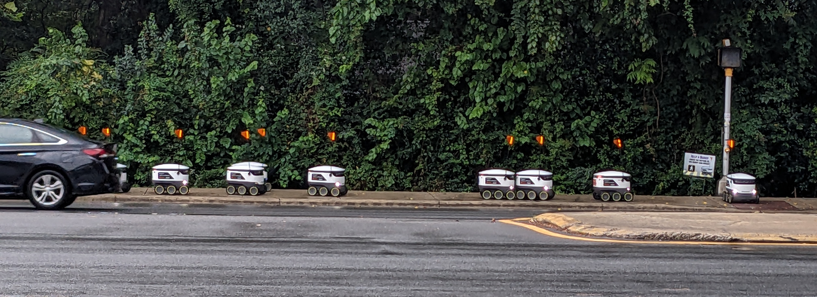
It is possible…

Slide 10
The Big 3 of Computer Vision
Detection/Recognition – Is a certain object in this image?
Classification – What is the object in this image?
Segmentation – What pixels make up the object?
These are not necessarily isolated from each other!

Slide 11
Let’s start with detection…

Slide 12
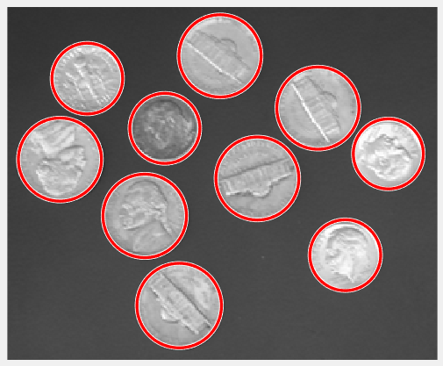
Example Problem: Detection/Extraction
Goal: Find all of occurrences of some known object, shape, etc.

Slide 13
Detection/Extraction
Goal: Find all of occurrences of some known object, shape, etc.
Where do you look in the image?
  Templates (Sliding Window)
  Multi-resolution Pyramids
  Voting Systems (Hough Transform)
How do you know when you have a match?
  Colors or grayscale values
  Edges
  Histograms of colors
  Histograms of oriented gradients

Slide 14
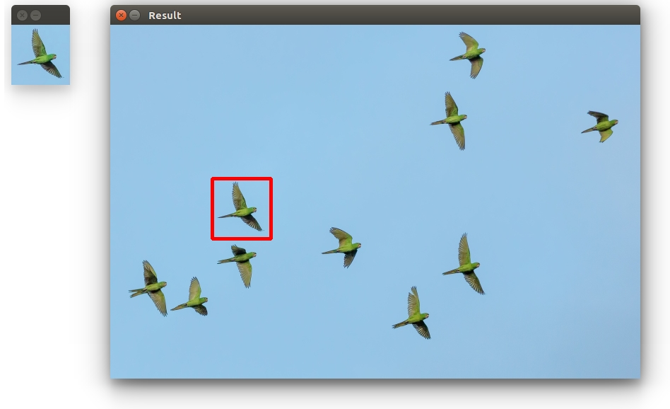
Template Matching (Sliding Window)
Ie take the one bird and slide across the picture to see other matches, online downfall is if bird wings are positioned different, it may not come up as similar. And also a lot of work checking every
Single pixel.
Suppose you have a picture of what you’re looking for:
  intensities/color
  configuration
Key idea: match parts of the image to the template image
  Good: very simple
  Bad: not very robust
Challenge:
  how do you define similarity?
  how do you implement it efficiently?

Slide 15
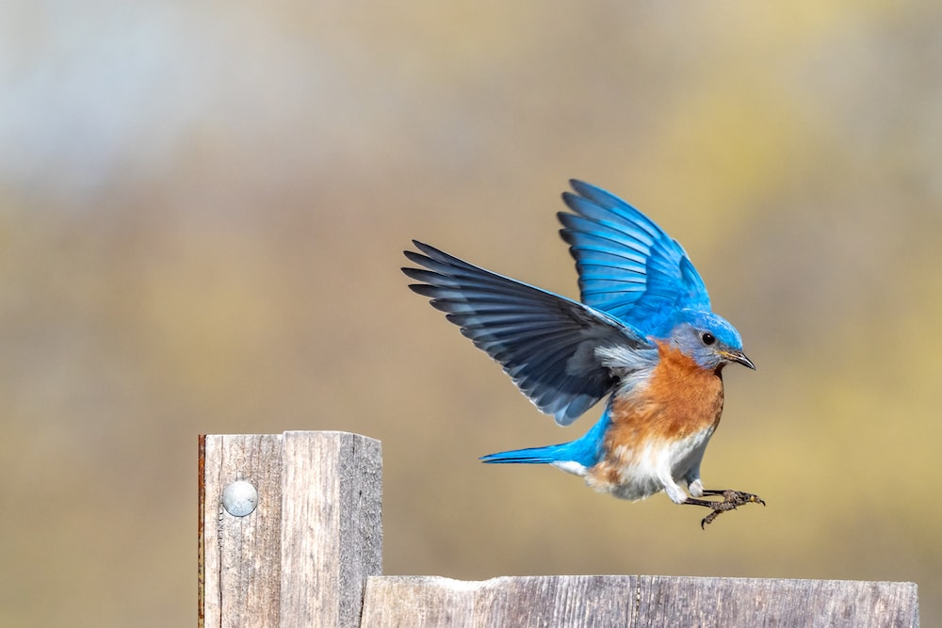
It is not robust
It is the bird

Slide 16
It is not robust
Because the rotation causes difference in pixel colors and angles, so not robust.
It is definitely
not the bird

Slide 17
It is not robust
Not good because just because the bird was scaled, it says it is not the same.
It is definitely
not the bird

Slide 18
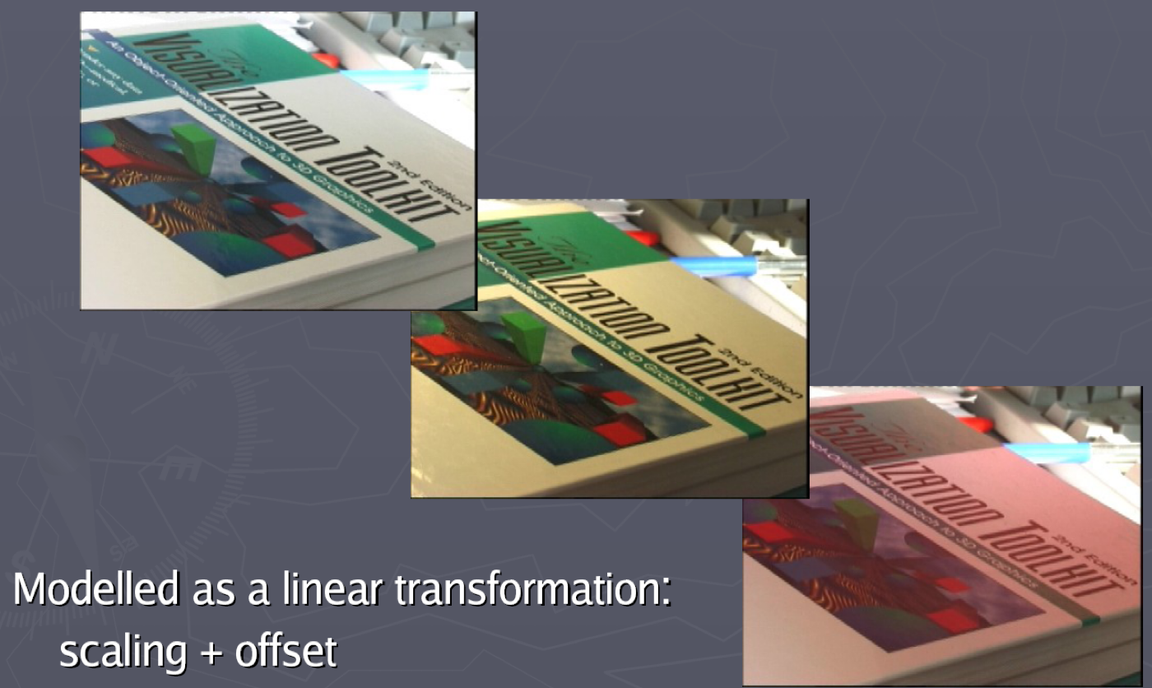
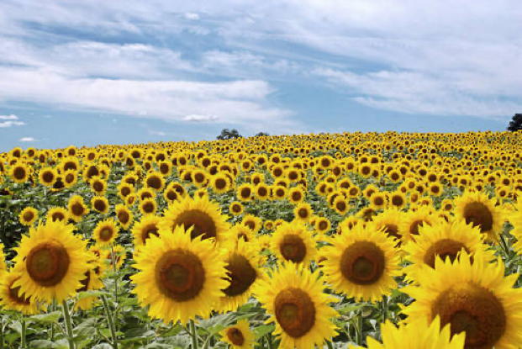

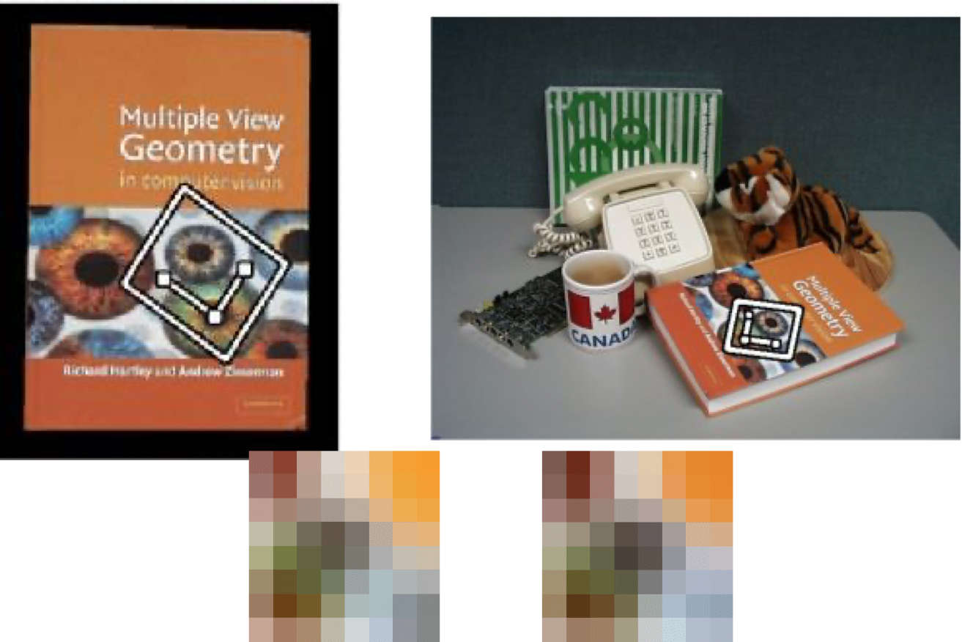
Detour: Invariance
Invariance: the degree to which some feature stays the same under different image transformations
  Translation (position)
  Rotation
  Scale
  Perspective
  Illumination
For robustness, it is important to be as invariant as possible

Slide 19
How do we handle differences in scale?
We tackle the problem one at a time so robustnesss can be achieved.

Slide 20
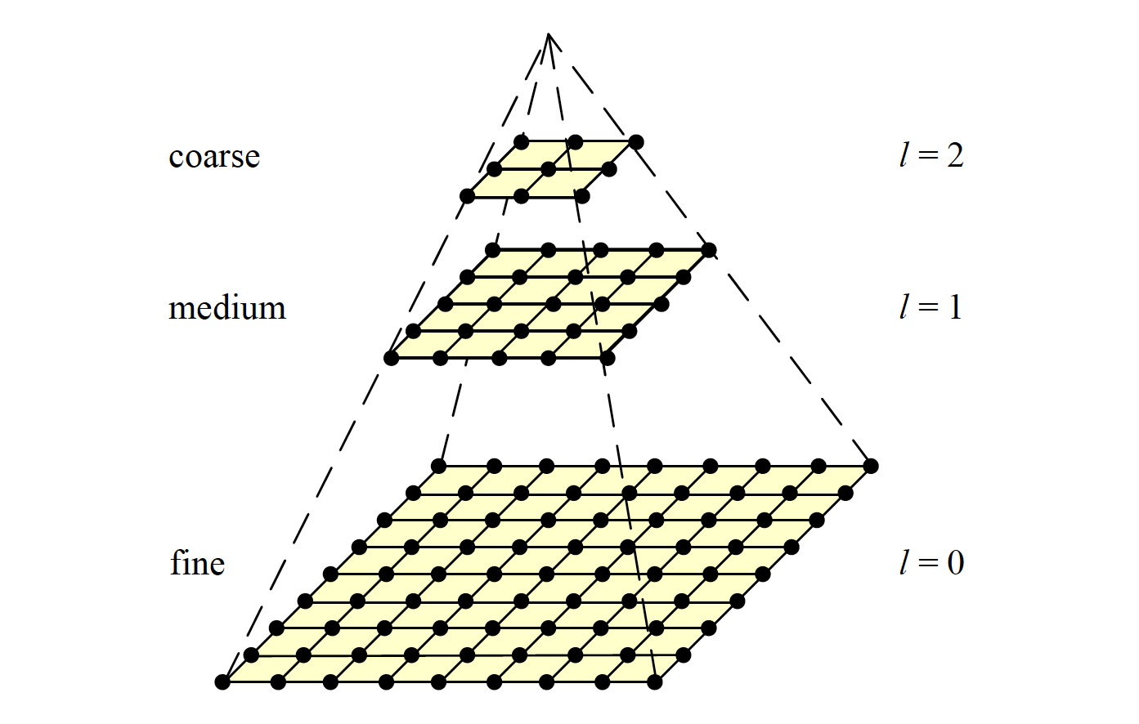
Multiresolution Pyramids
Say fine is the original image, we perform multiple shrinkings at the different levels to provide multiple sizes of our image, so that when comparing
We can have a match with any of the scaled images.

Slide 21
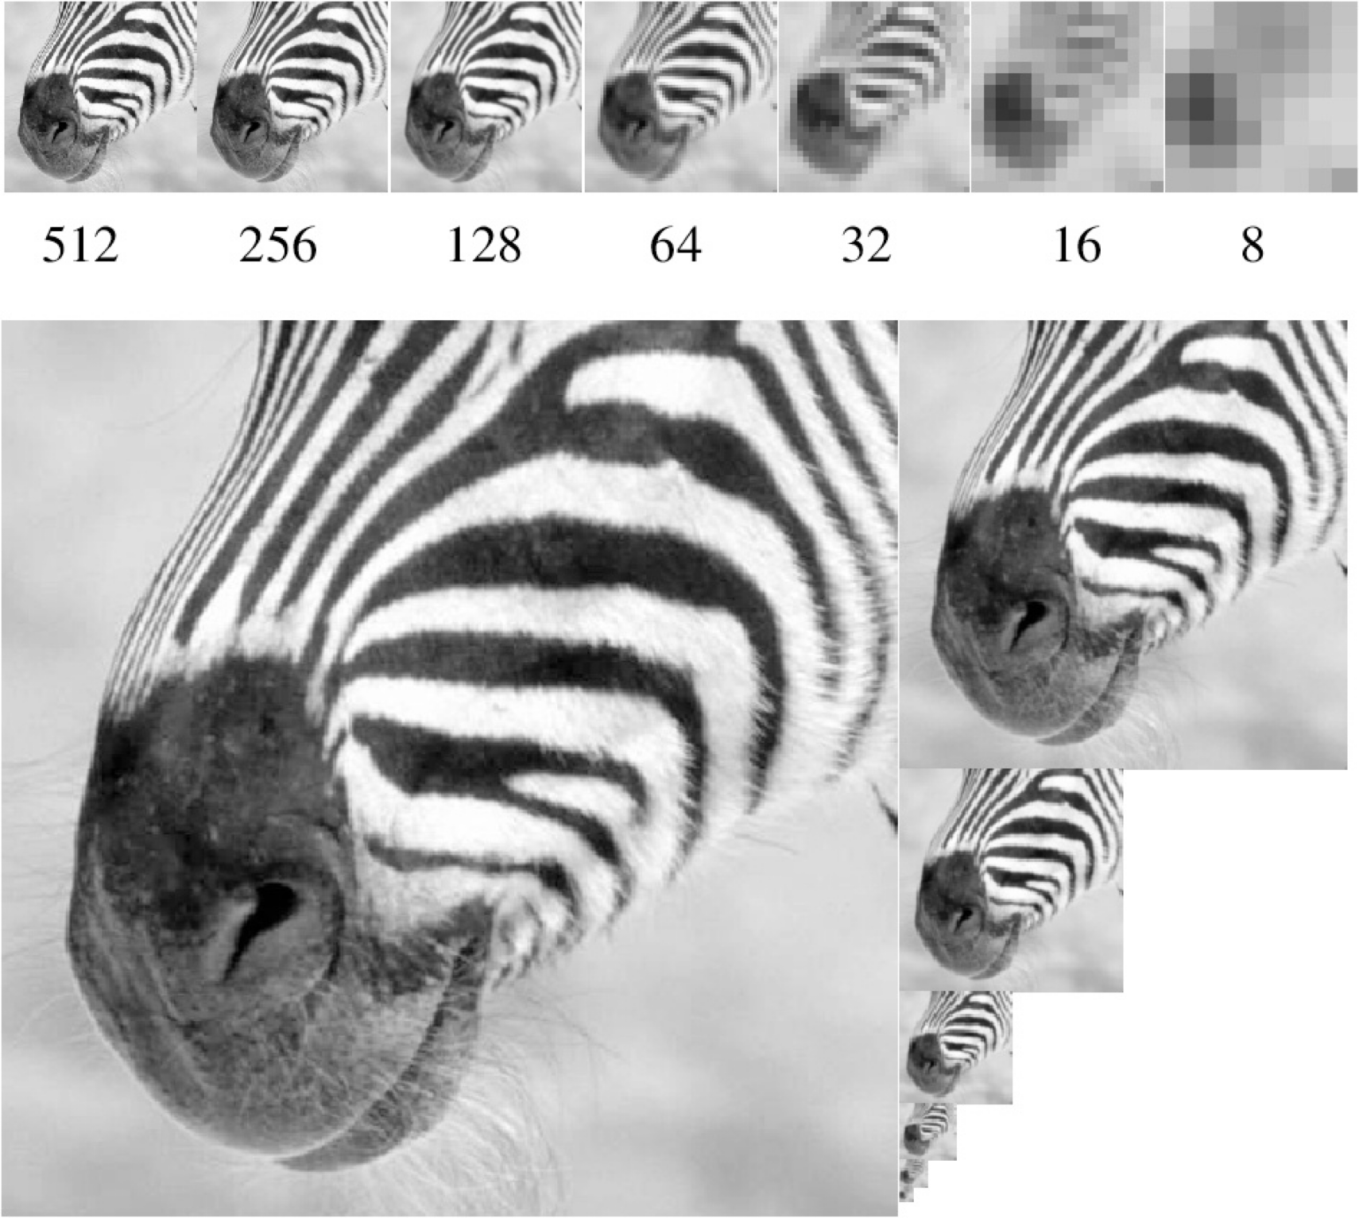
Multiresolution Pyramids
The problem here is for intermediate resolutions like 300 that don’t match the scale exactly would not be identified.

Slide 22
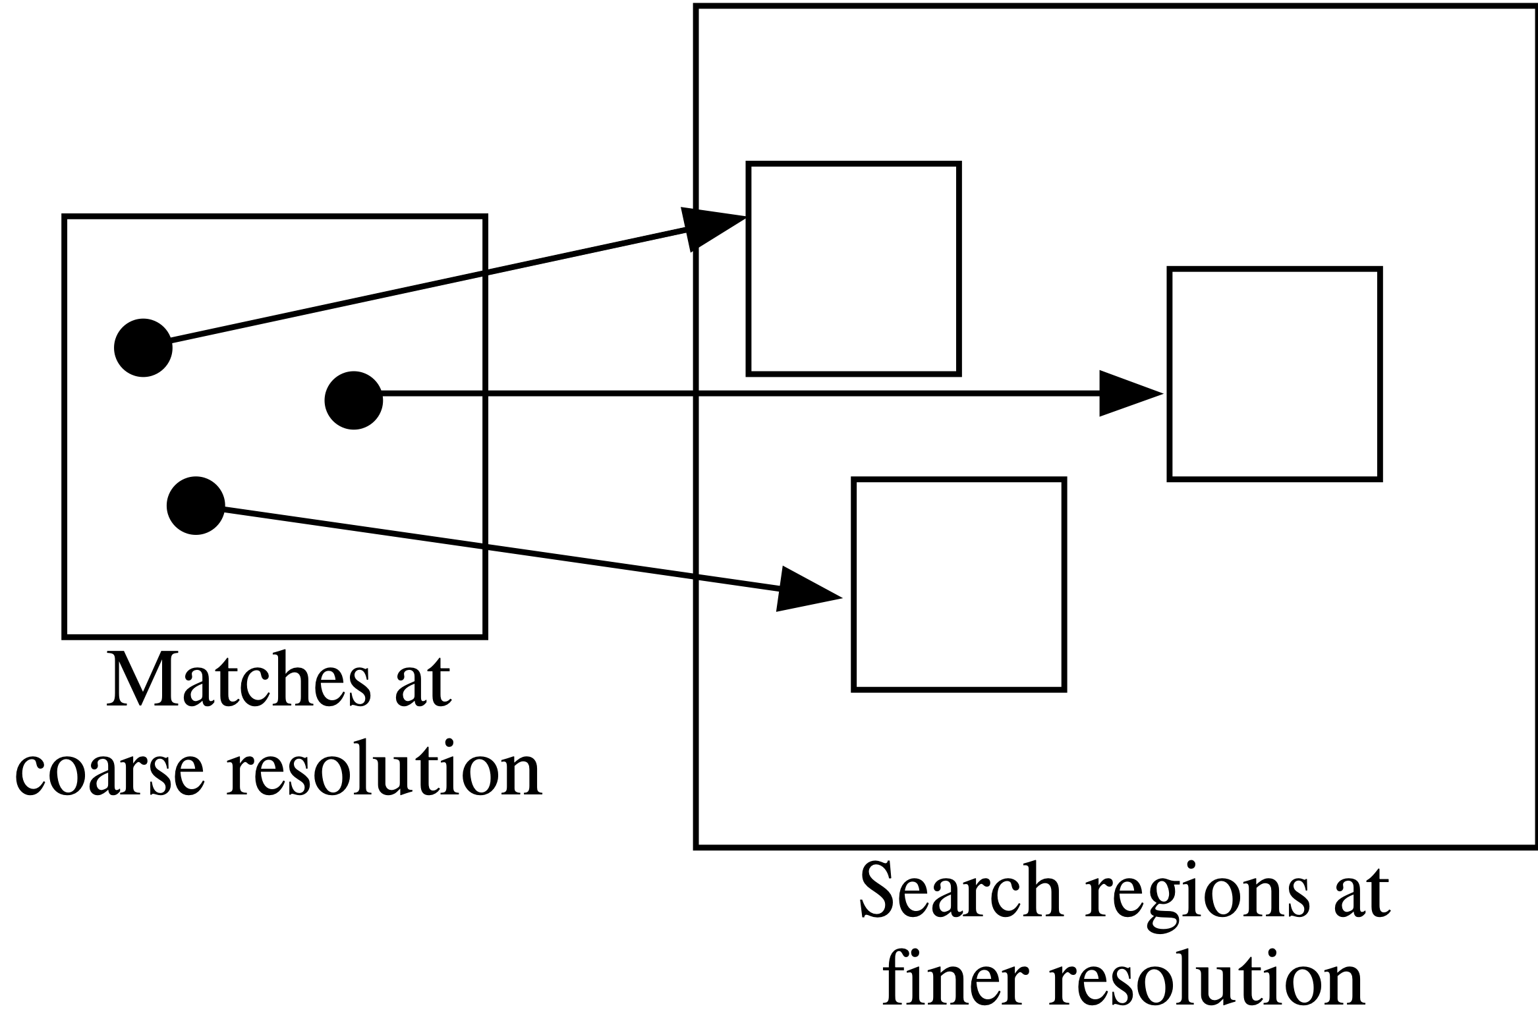
Multiresolution Pyramids

Slide 23
How do we handle differences in rotation, pose, and shape?
One way is to design better features to match

Slide 24
Matching Features
In the simplest setup, we look at all RGB or grayscale values and compare.
If the difference in values is below some threshold, we consider it a match.
What other features could we match instead?

Slide 25
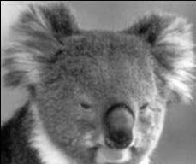
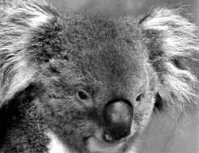
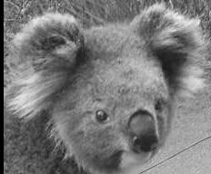
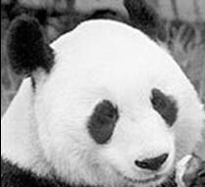
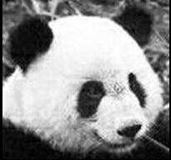
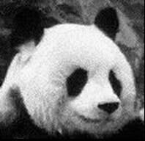
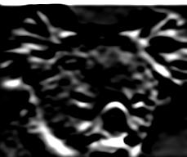
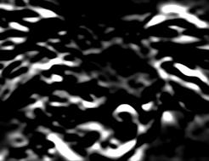
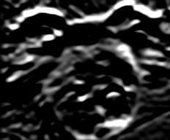
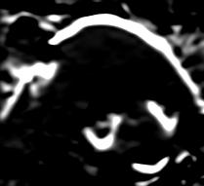
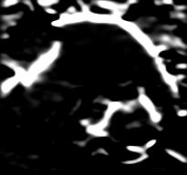
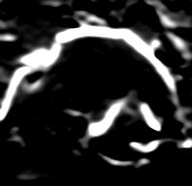
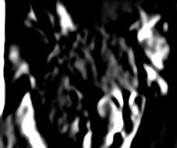
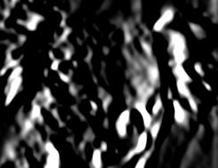
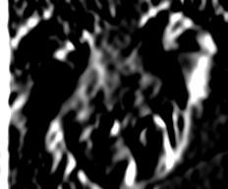
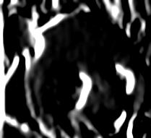
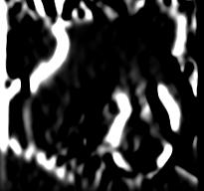
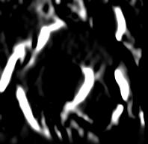
Edges and Gradients
The edge intensities or their oriented gradients are often better features to compare than direct RGB values

Slide 26
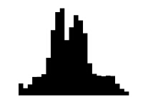
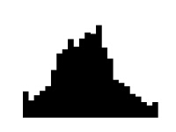
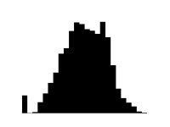



Histograms of Color
The downfall is if the picture was taken at night, then using color makes the distribution look so different even if the pictures are the same.
Describe image as a histogram of grayscale/color values
Similar image content should have similar histograms.

Slide 27
Problem: Shifting and Illumination
Pixel-based representations sensitive to small shifts
Color or grayscale-based appearance description can be sensitive to illumination and intra-class appearance variation

Slide 28
Solution: Histogram of Gradients
A histogram of the oriented gradients (which way each edge faces) is a more robust feature representation of the image content.

Slide 29
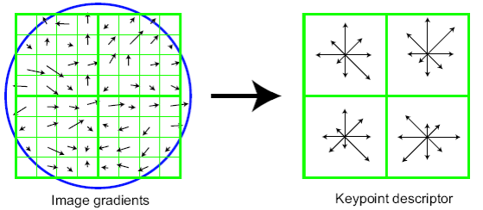
Even Better: Patched-based HoG
Compute Histogram of Gradients (HoG) for patches of the image.
  Locally orderless: offers invariance to small shifts and rotations
  Contrast-normalization: naturally corrects for variable illumination
  Better generalization: less variant to background content

Slide 30
Let’s try it in NumPy…

Slide 31
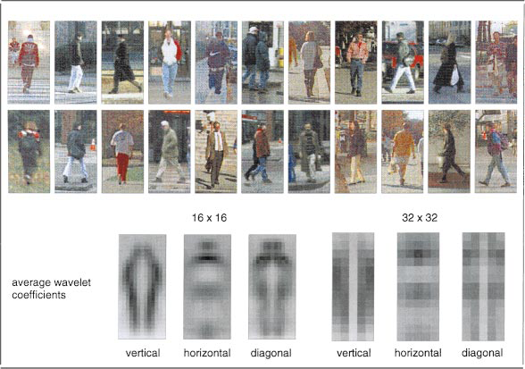
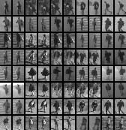
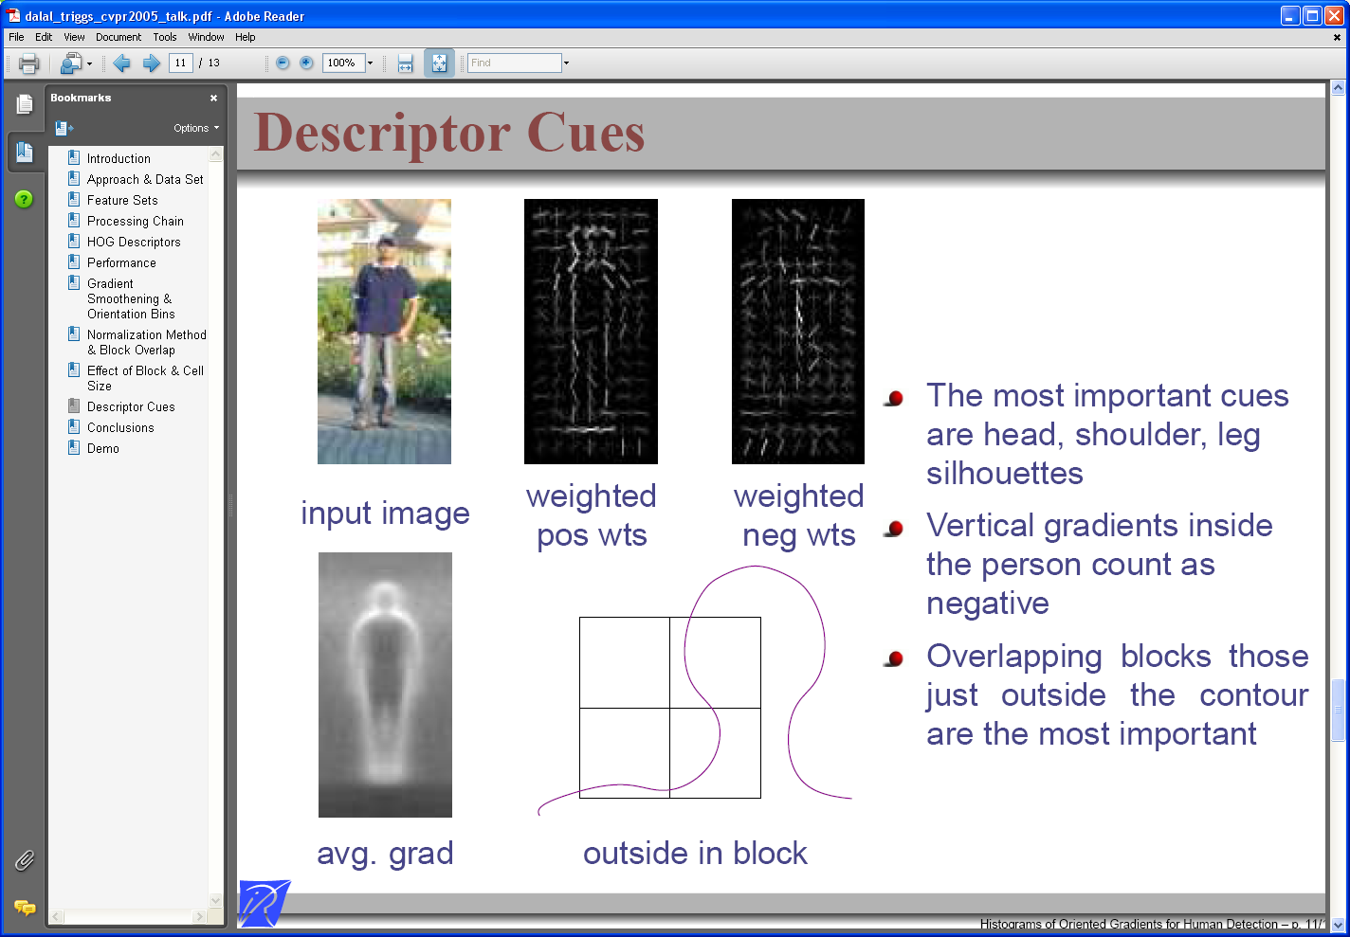
Example: Pedestrian Detection
SVM with Haar wavelets [Papageorgiou & Poggio, IJCV 2000]
Space-time rectangle features [Viola, Jones & Snow, ICCV 2003]
SVM with HoGs [Dalal & Triggs, CVPR 2005]
Detecting upright, walking humans also possible using sliding window’s appearance/texture; e.g.,

Slide 32
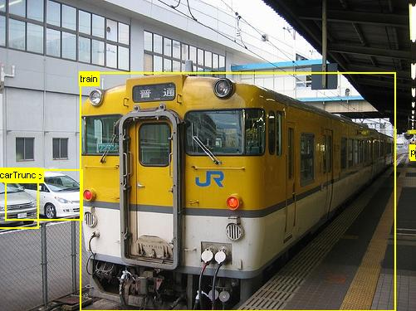
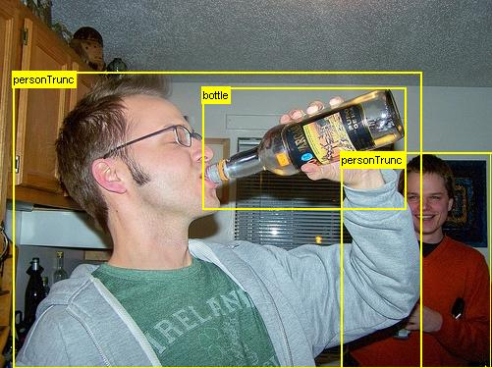
Limitations
Not all objects are “box” shaped

Slide 33
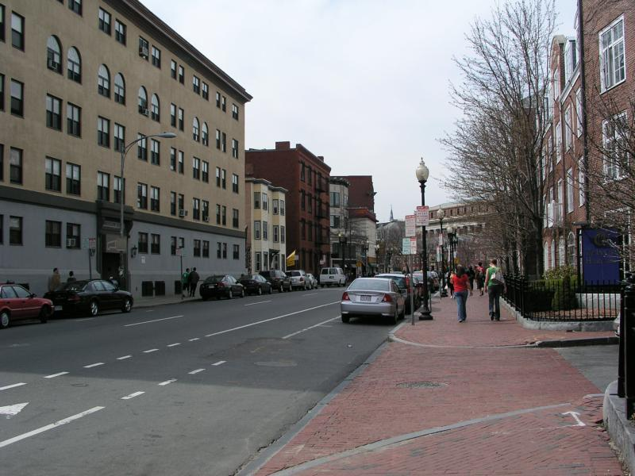
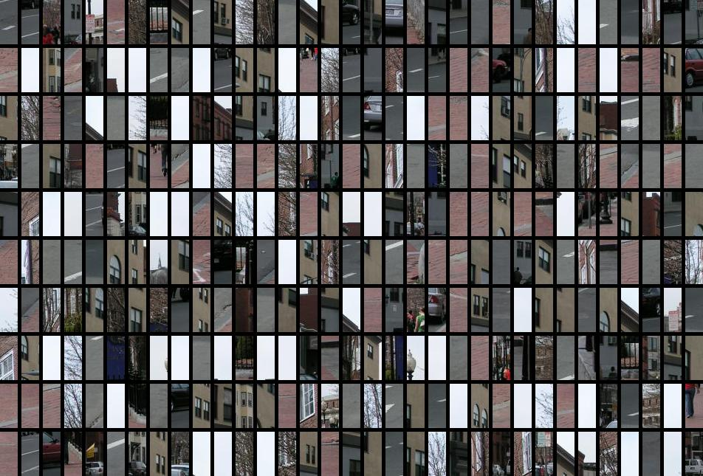
Limitations (continued)
Sliding window
Detector’s view
If considering windows in isolation, context is lost
Figure credit: Derek Hoiem

Slide 34
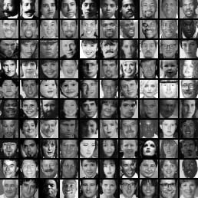
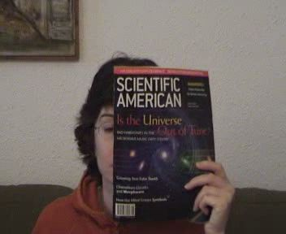
Limitations (continued)
In practice, often needs a large and cropped training set (expensive)
Requiring good match to a global appearance description can lead to sensitivity to partial occlusions
Image credit: Adam, Rivlin, & Shimshoni

Slide 35
Deformable Part Model
Idea: for complicated/deformable things, it may be easier to detect simpler parts and their spatial relationships
“Root filter”:
  detect candidates using lower-resolution versions
“Part filters:
  Uses HOG features and a sliding-window approach for detection in higher-resolution version
  Don’t use hand-selected training sets for each part but instead learn commonalities from positive/negative training examples of the larger object
  Use labeled parts as positive examples and randomly crop other parts of the image for negative ones
Configuration:
  Define each part’s placement relative to root
Overall score is sum of root / parts / deformation costs
Trained using a Latent SVM that includes the part configuration as a latent variable (z) to be learned
from “Object Detection with Discriminatively Trained Part Based Models”
by Felzenszwalb, Girshick, McAllester, and Ramanan

Slide 36
What if you know the exact shape you are looking for?

Slide 37
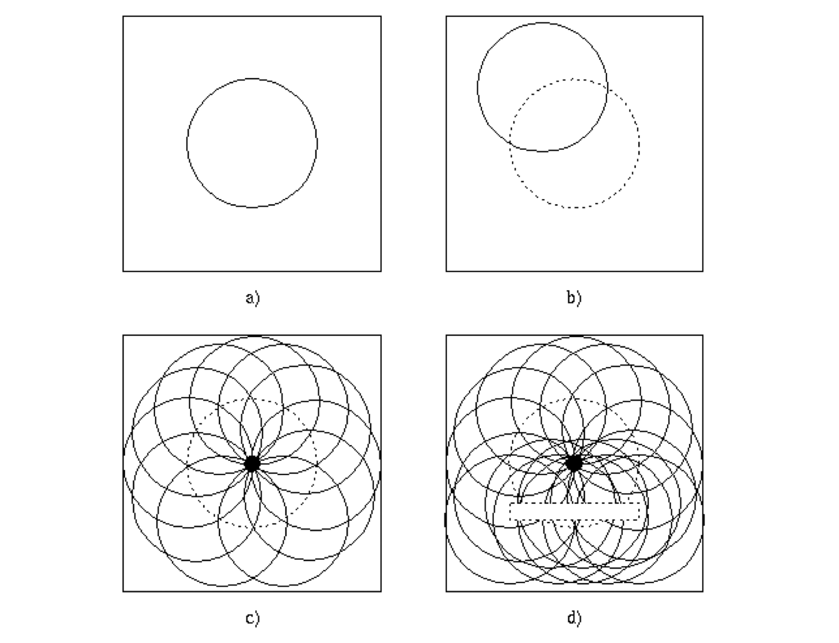
Hough Transform
Key idea: find edge points and let them
vote for where the shape might be
Limitation: must know the target shape ahead of time (circles, lines, etc.)
Advantages:
  for large things, it can be much more efficient than template matching
  robust to noise, dropout, etc.

Slide 38
Applications
The Hough transform is still widely used in “classical” computer vision applications
Example:
  Find edges
  Find lines
  Use lines to find vanishing points
  (can be done by voting!)
  Use vanishing points to reconstruct
  3D geometry, buildings, etc.

Slide 39
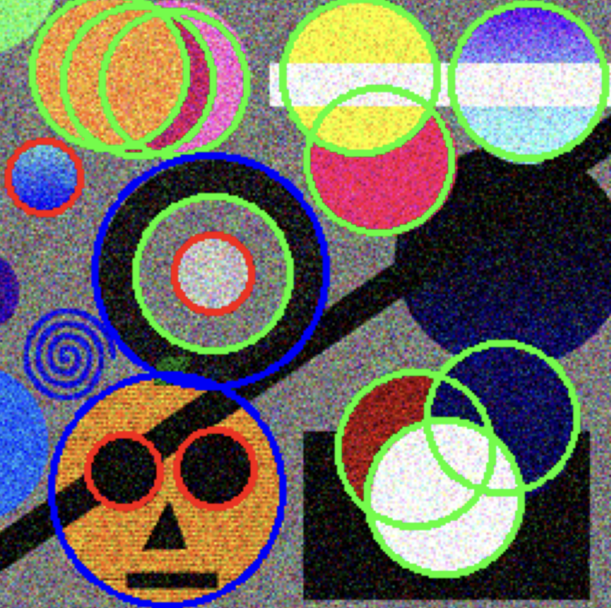
Extra Credit Lab: Hough Transform
If you would like to learn more about the Hough Transform, additional slides are provided at the end of this presentation.
Additionally, you can practice using the Hough Transform to detect circles in the Hough Transform extra credit lab on Canvas.

Slide 40
Detection/Extraction
Goal: Find all of occurrences of some known object, shape, etc.
Where do you look in the image?
  Templates (Sliding Window)
  Multi-resolution Pyramids
  Voting Systems (Hough Transform)
How do you know when you have a match?
  Colors or grayscale values
  Edges
  Histograms of colors
  Histograms of oriented gradients

Slide 41
While these approaches are good and still used in many contexts, there is a much better way to do feature matching. We will talk about this next time…

Slide 42
Additional Hough Transform Slides

Slide 43
Finding Shapes
Problem with templates:
matches pixel intensities, not shapes
Various fitting approaches:
  Hough transform - voting based
  Chamfer matching - distance maps
  RANSAC – statistical (we’ll come back to this later)

Slide 44
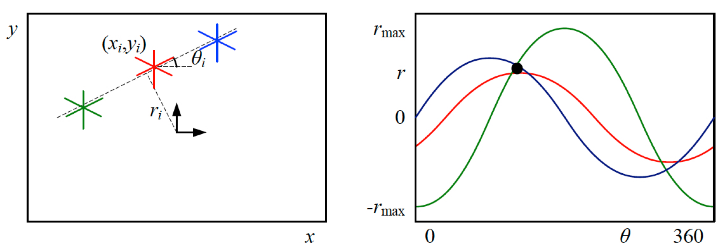
Hough Transform - Lines
Basic Idea (line finding version):
  Find all features of interest (usually edge points)
  Let each one “vote” for each of the lines through it
  Use an accumulator to count the votes from all features
  Most votes wins

Slide 45
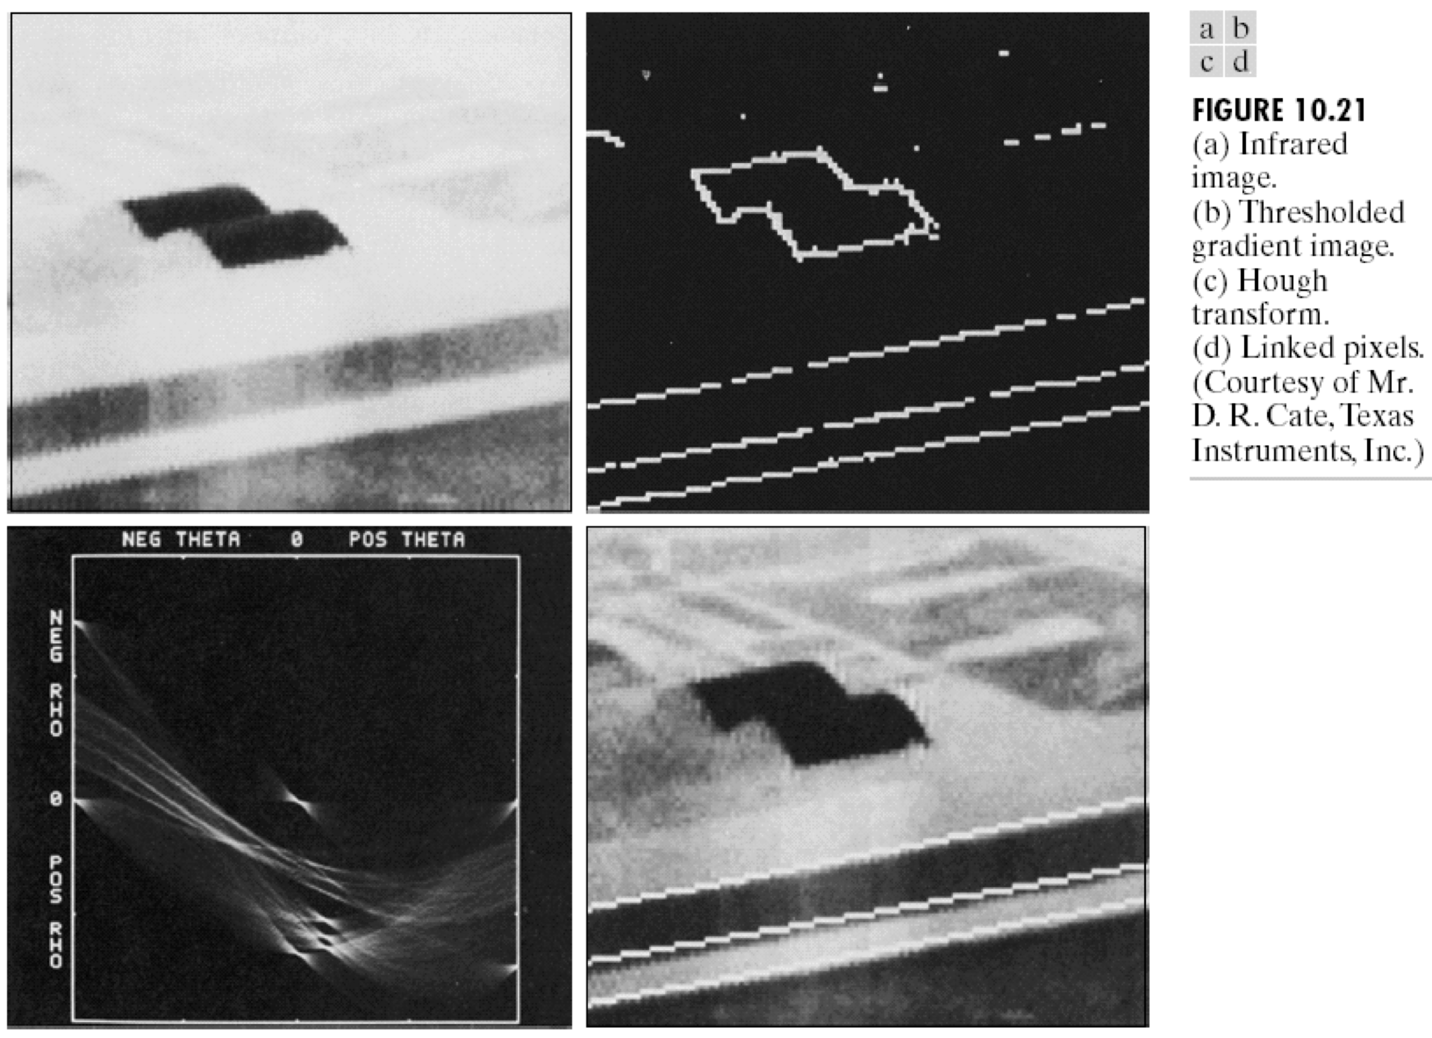
Example

Slide 46
Parameterizing Shapes
Many simple shapes can be described by a small number of parameters
These parameters define the dimension of the shape’s parameter space

Slide 47
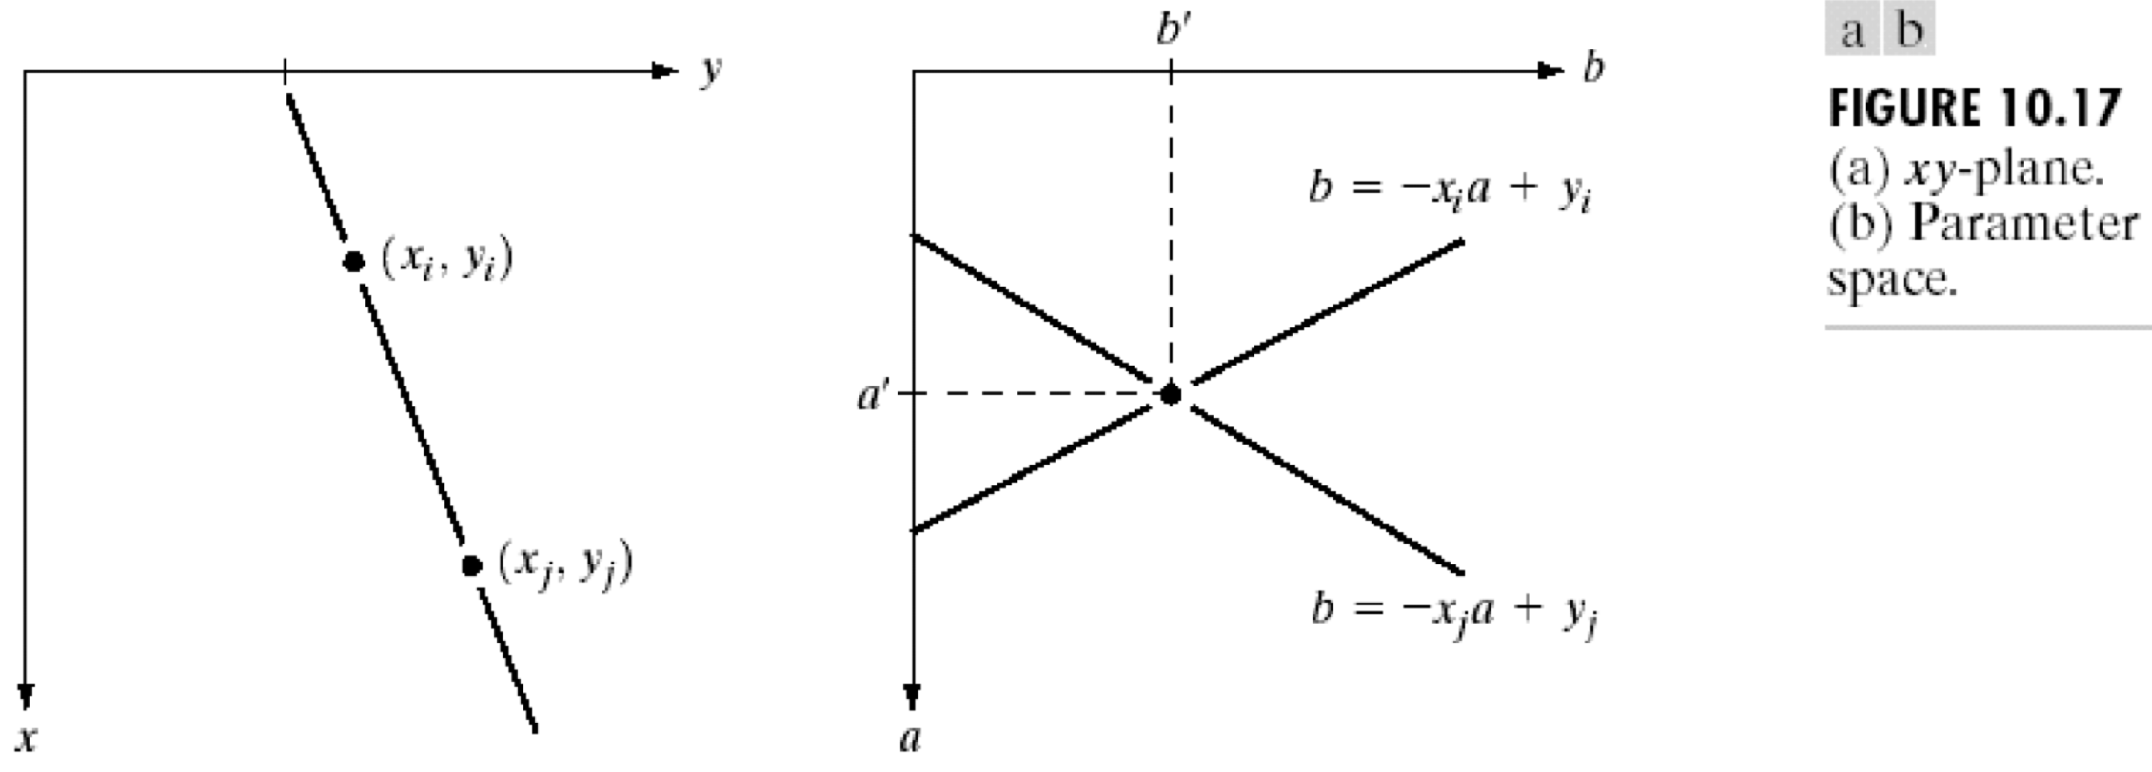
Parameter Spaces
A point (x,y) in image space defines a line in (a,b) parameter space
A point (a,b) in parameter space defines a line in (x,y) image space

Slide 48
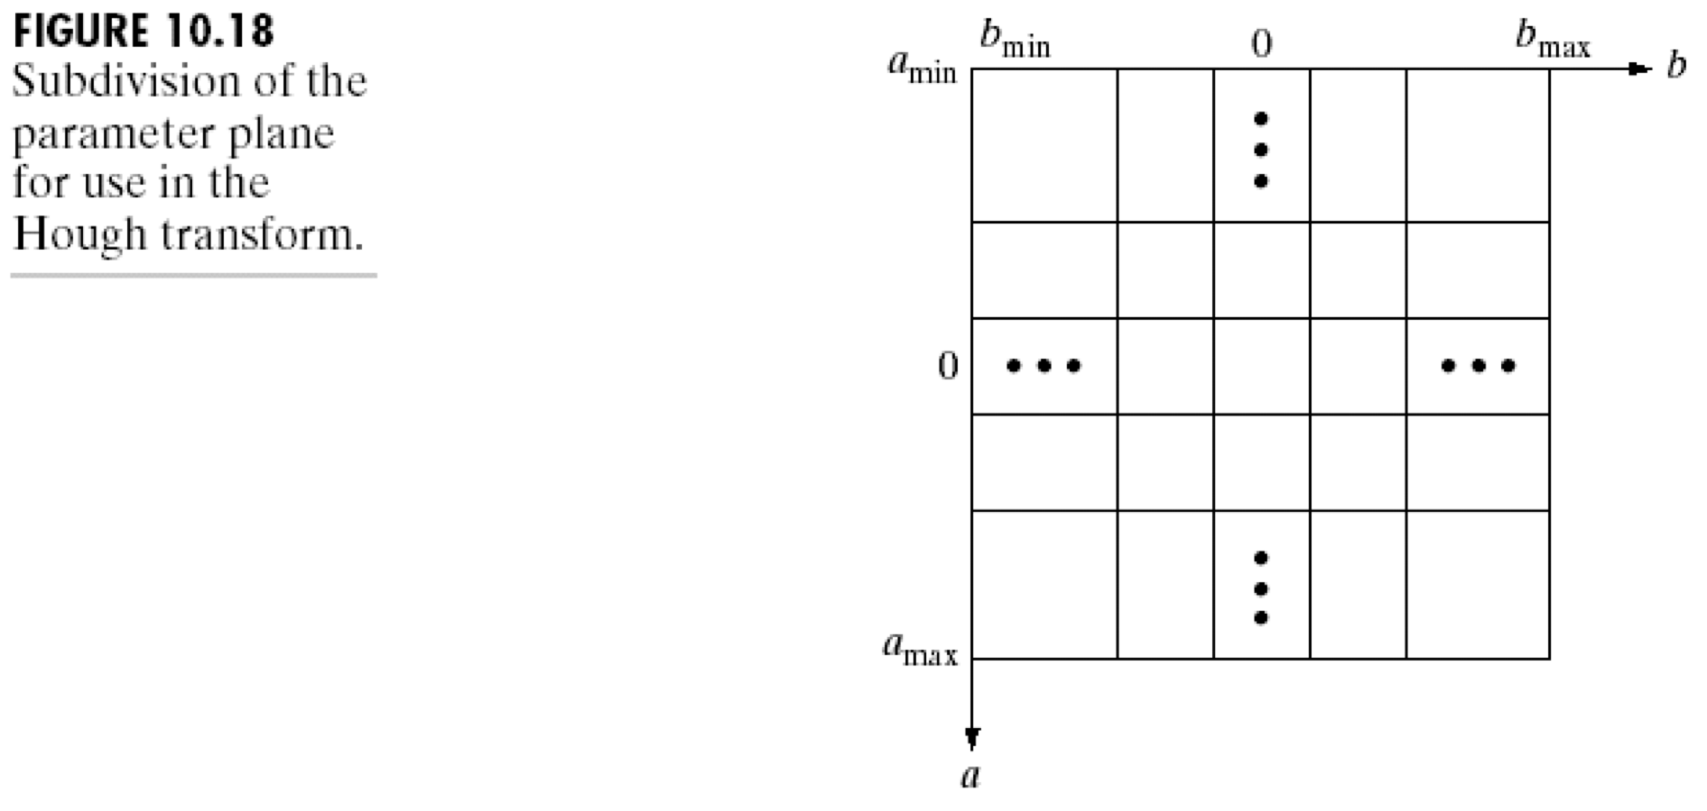
Accumulators
Can’t vote for all (infinite) possible lines, so discretize the parameter space
Store an array that accumulates the votes

Slide 49
Algorithm
Find all of the desired feature points (edges) in the image
For each feature point xi:
  For each satisfying parameterization pj:
    Increment that position pj in the accumulator
Find maxima in the accumulator
If desired, map each maximum back to the image space

Slide 50
Hough Transform - Lines
Each feature (edge) point maps to a sinusoid in the parameter space

Slide 51
Circles
Parameterize by center (x,y) position
if radius is known
  Each edge point forms a circle in parameter space
Add a third parameter for the radius if not
  Each edge point forms a cone in parameter space

Slide 52
Hough Transform
Key idea: find edge points and let them
vote for where the shape might be
Limitation: must know the target shape ahead of time (circles, lines, etc.)
Advantages:
  for large things, it can be much more efficient than template matching
  robust to noise, dropout, etc.

Slide 53
Applications
The Hough transform is still widely used in “classical” computer vision applications
Example:
  Find edges
  Find lines
  Use lines to find vanishing points
  (can be done by voting!)
  Use vanishing points to reconstruct
  3D geometry, buildings, etc.

